Slide 1
Fitness buddy agent
IBM AICTE PROJECT
Presented By:
Priayanshu Sahai - Shri Ramswaroop Memorial University -B.Tech CSE

Slide 2
OUTLINE
Problem Statement
Technology used
Wow factor
End users
Result
Conclusion
Git-hub Link
Future scope
IBM Certifications

Slide 3
Problem Statement
In today’s fast-paced world, many individuals struggle to maintain a healthy lifestyle due to lack of personalized guidance, time constraints, and inconsistent motivation. Traditional fitness solutions often require expensive subscriptions, in-person consultations, or rigid schedules that don't adapt to personal preferences or daily routines. There is a growing need for an accessible, friendly, and intelligent virtual assistant that can provide on demand fitness advice, healthy lifestyle suggestions, and basic nutrition guidance—all tailored to individual needs and available at any time.

Slide 4
Technology used
Purpose | Technologies
💬 Chat Interface | IBM Watson Assistant or Watsonx Assistant
🧠 AI/NLP | IBM Watson NLP, OpenAI (for reasoning), Granity (IBM’s LLM)
📦 Backend | Python (Flask or FastAPI) or Node.js
🌐 Frontend | HTML + CSS + JS (Vanilla or React), or mobile app (Flutter/React Native)
☁️ Cloud Platform | IBM Cloud (Lite plan or Code Engine for deployment)

Slide 5
IBM cloud services used
IBM Cloud Watsonx AI Studio
IBM Cloud Watsonx AI runtime
IBM Cloud Agent Lab
IBM Granite foundation model
IBM Watson NLP

Slide 6
Wow factors
AI-Powered Dynamic Fitness Coach
A conversational assistant that adapts workouts in real-time based on:
User mood (detected via sentiment analysis)
Weather (e.g., switch to indoor workouts when it rains)
Energy levels (“I feel tired today” → low-intensity workout)
Posture Detection & Feedback (via Image or Video Upload)
Let users upload photos/videos of their workouts, and the AI:
Detects posture errors (e.g., wrong plank form)
Provides tips using computer vision (IBM Granity or custom model)
Adds gamification: “Great form! Keep going!”
Progressive Smart Planner
Learns and adapts as user habits evolve:
If someone skips workouts on weekends, it suggests flexibility.
Recommends mini-goals: “Let’s aim for 3,000 more steps today.”
Also shows motivational stats:
“You’ve burned 3,200 calories this month. That’s 10 donuts!”

Slide 7
End users
Academic Researchers
Research Institutions and Universities
Industry R&D Teams
Educators

Slide 8
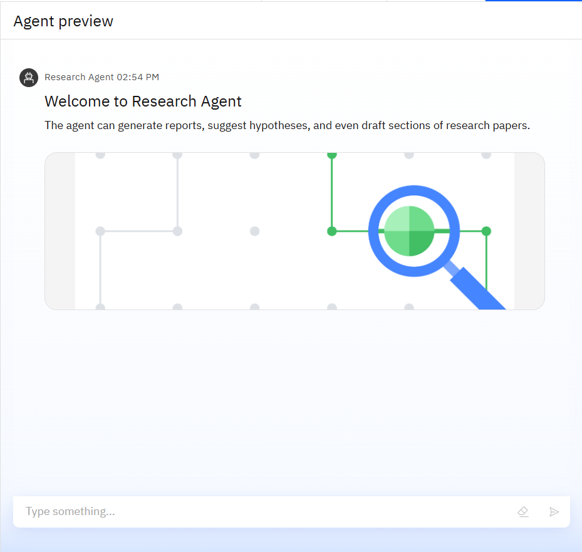
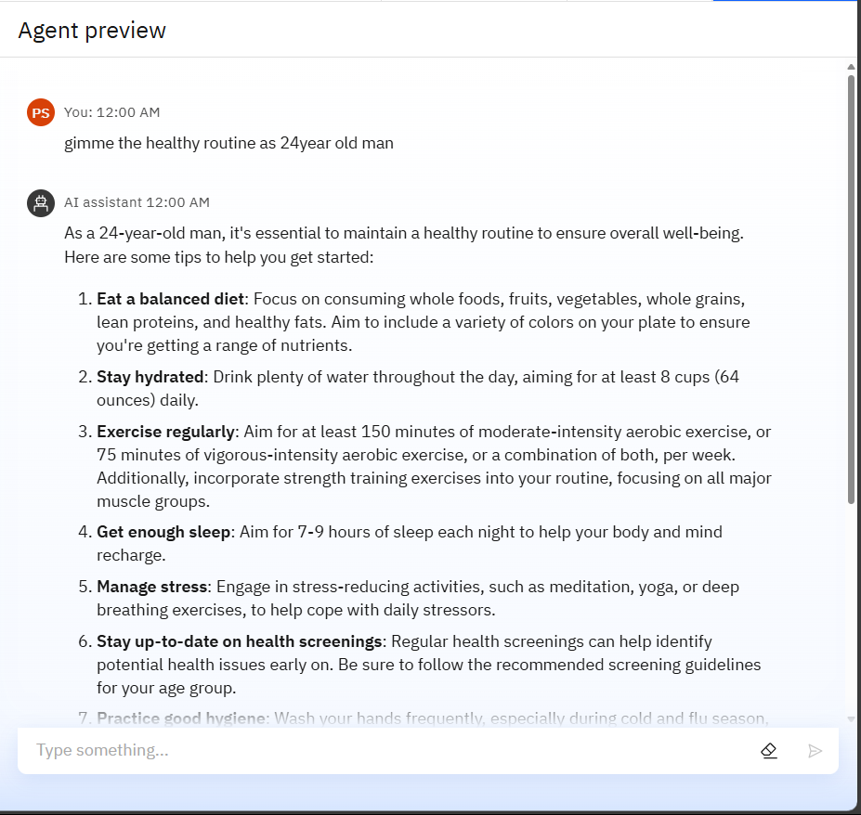
Results

Slide 9
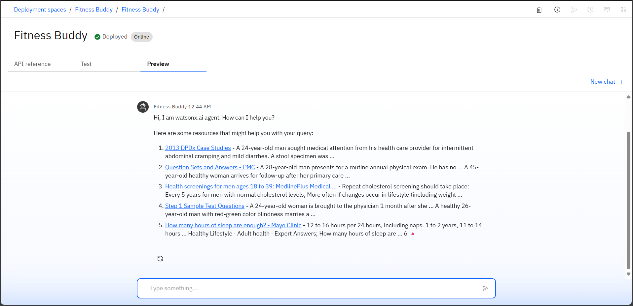
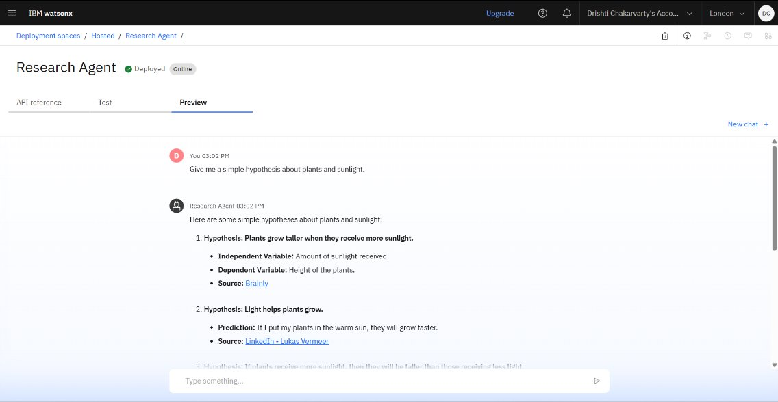
Results
Deployed AI Agent

Slide 10
Conclusion
Fitness Buddy harnesses the power of AI and IBM Cloud technologies to deliver a personalized, intelligent, and accessible health companion. By combining natural language understanding, real-time feedback, and adaptive fitness and nutrition recommendations, it bridges the gap between rigid fitness apps and expensive personal coaching.
Through features like tailored home workouts, motivational tips, smart meal suggestions, and habit-building encouragement, Fitness Buddy empowers users to take charge of their wellness journey—anytime, anywhere. With scalable cloud infrastructure and generative AI, this project not only promotes healthier lifestyles but also showcases how AI can truly care, coach, and connect.

Slide 11
GitHub Link
https://github.com/priyanshusahai/Fitness-Buddy

Slide 12
Future scope
Integration with Wearables & IoT Devices
AI-Based Posture and Form Correction
Emotional Well-being & Mental Health Support
Voice-Only Mode & Smart Assistant Integration
Multilingual Support
Gamification & Community Challenges
AI Coach Learning from Progress
Integration with Medical Records & Healthcare Providers

Slide 13
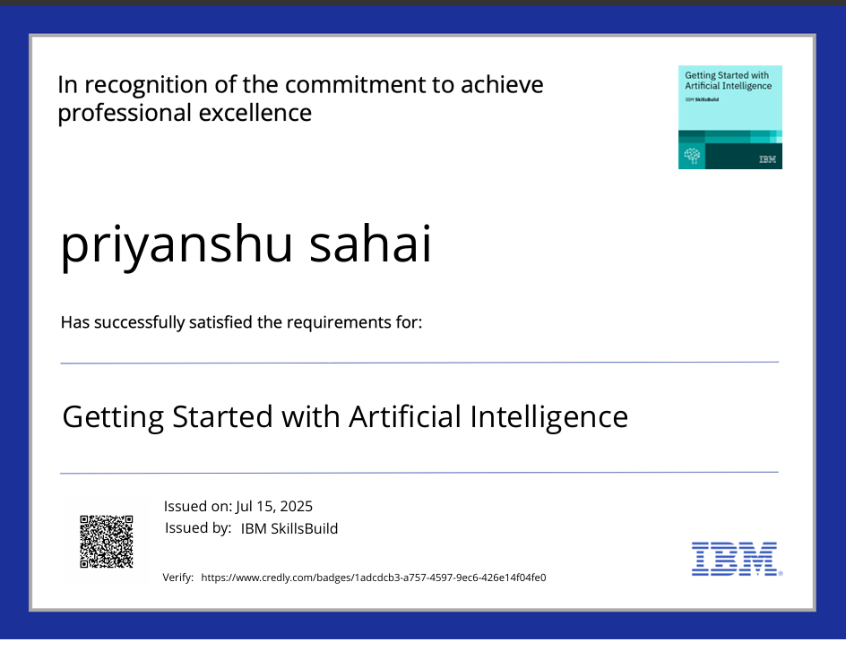
IBM Certifications
Screenshot/ credly certificate( getting started with AI)

Slide 14
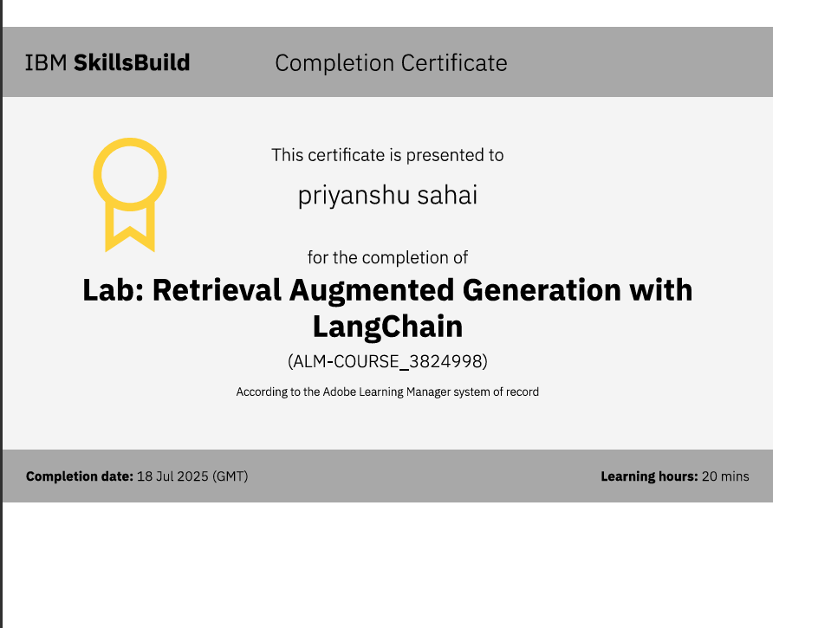
Attach your RAG LAB certificate here

Slide 15
THANK YOU

